Slide 1
CSS3 In-Depth

Slide 2
Agenda
Media Queries
Selectors
Box properties
Layout
Animations
Good practices

Slide 3
Media Queries
A media query consists of a media type and at least one expression that limits the style sheets' scope by using media features, such as width, height, and color.
There are three ways to use media queries:
Link
@import
@media

Slide 4
Selectors
Selectors can be broadly separated into two categories. The first are those that act directly on elements defined in the document tree (p elements and href attributes, for example); this category contains class, type, and attribute selectors. The second category contains pseudo-selectors that act on elements or information that sits outside of the document tree(such as the first letter of a paragraph or the last child of a parent element).

Slide 5
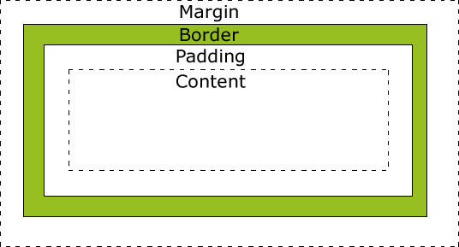
Box properties
Every HTML element has box properties. These are the properties that control how the element is spaced on the page and control the position of the box contents. In addition, the graphic effects can be applied to the box of an element.

Slide 6
Layout
We a couple options of building layout:
1.Flexible box model
2.Multi-column
3.Grid alignment
4.Regions

Slide 7
Grid alignment
#mainGrid {
display: grid;
grid-columns: 150px 150px 150px 150px;
grid-rows: 75px 75px;
}
#mainGrid > div:nth-child(4){
grid-column: 4;
grid-row:1;
/*grid-column-span: 3;*/
background-color: green;
}

Slide 8
4.Regions
E { flow-into: foo; }
F, G { flow-from: foo; }

Slide 9
Animations
The modern day website is an interactive experience for the end user. CSS3 provides many mechanisms to apply a professional touch to the end-user interaction. This is achieved through the ability to animate and transform objects.
Animations can be performed by built in methods like transform but also we can use pseudo-classes to make our site more attractive.

Slide 10
Good practices
Don’t qualify ID, class rules with tag names or classes
Use the most specific category possible
Avoid the descendant selector
Tag category rules should never contain a child selector
Rely on inheritance

